Slide 1

CS 69099 Capstone Project-Data Science
Group-04
Tanuja 811196911
Kaushik 811190141
Spoorthi811228038
Shiva K 811235874

Slide 2
Problem Statement
The scope of the project is to extract the social network(Instagram, Facebook, twitter)data, when people post on their social media account’s and we just store those extracted data in graph database, later we just perform the different operations
We collect the open source datasets

Slide 3

Introduction:
Social network analysis basically described as a method for finding patterns under the structure of network.
The network basically consist of nodes which can be represented as a individual people and edges nothing but relationship between the nodes.
SNA is the mapping and measuring of relationships and flows between people, groups and other connected information/knowledge.

Slide 4
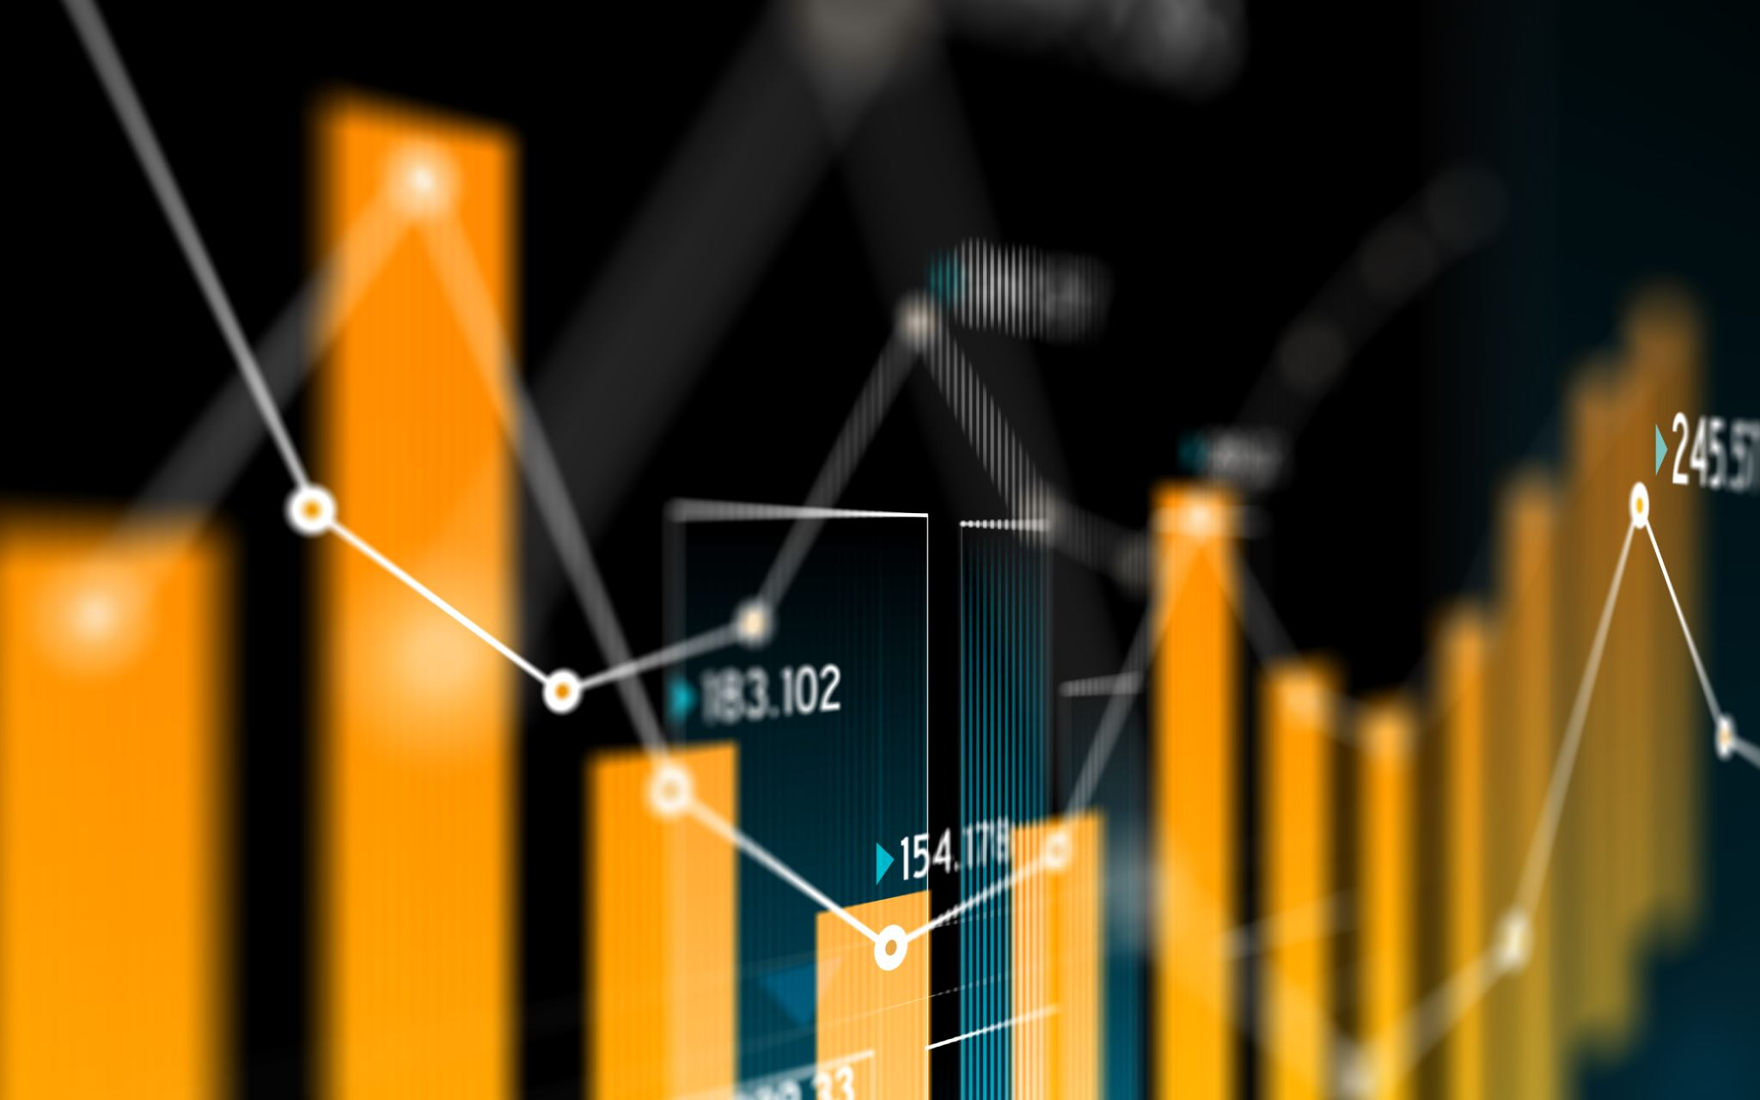
Importance of data extraction:
Better customer targeting and retaining existing customers.
Reduce operational cost.
You will get more accurate data or information about people so can focus on your business what people needs.
Provide recommendations for people based on their activity what they search on social media.
Notes:
Facebook algorithm, google adsense ads displaying

Slide 5
Data analysis process:
Data requirement gathering
Data collection
Data Cleaning
Data analysis
Data interpretation
Data visualization
Basically we perform ETL Process (plays crucial roe in formulating the different types of databases)

Slide 6
Data Storage:
Graph Database:
A graph database basically stores entities as nodes and relationship as edges.
Kind of powerful tool for graph-like queries.
Graph database can be described as a single-purpose platform for creating and manipulating graphs.
Graph contain nodes, edges and properties all of which are used to represent and store the data in a way that relational database can’t do.
Nodes: The main entities in a graph. We can consider them it as a row in a relational database.
Relationships: The connection between those entities, kind of foreign keys in a relational database.
Labels: Attributes that group similar nodes together.
Properties: Key/value pairs stored within nodes.

Slide 7

Issues:
As the data is huge, we might face issue in making judgment of useful data.
As querying we may come across long runtime when implementing a query or index , the specific need to use the cases of querying and indexing for a database upon the requirement need to maintained for efficient performance .

Slide 8
Tasks
Meet with group to discuss project requirements and objectives, define project scope and constraints, establish project team roles and responsibilities

Slide 9
tools
Github Kaggle for datasets as datasets can be available for free
Tableau prep for cleaning the data
Tableau desktop or public for visualisation (depends upon the size of file)
For Programming we are planning to use R or Python

Slide 10
Test cases
Analysing the data and some basic outcomes like gender wise analysis.
Guests attended for a conference like country wise gender.

Slide 11

Conclusion:
By performing social network analysis, it will be more advantage to understand people needs and even organizations can increase their business by understudying what people needs and even better recommend products for the people based on their data which we post online.

